Slide 1
Internal Control–Integrated Framework
May 2013

Slide 2
Table of Contents
COSO & Project Overview
Internal Control-Integrated Framework
Illustrative Documents
Illustrative Tools for Assessing Effectiveness of a System of Internal Control
Internal Control over External Financial Reporting: A Compendium of Approaches and examples
Transition & Impact
Recommended Actions
Questions & Comments

Slide 3
COSO & Project Overview

Slide 4
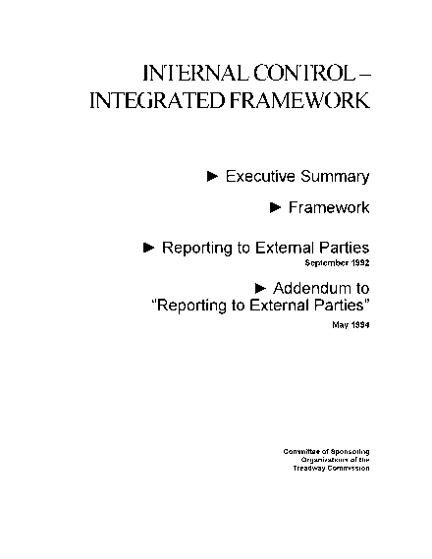
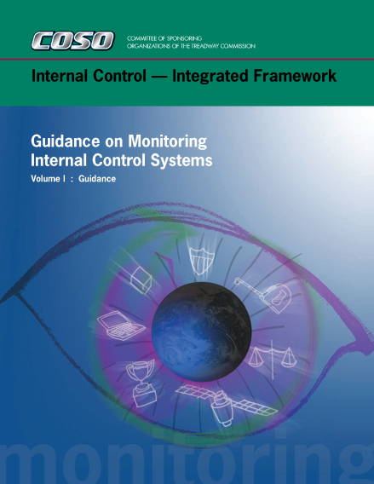
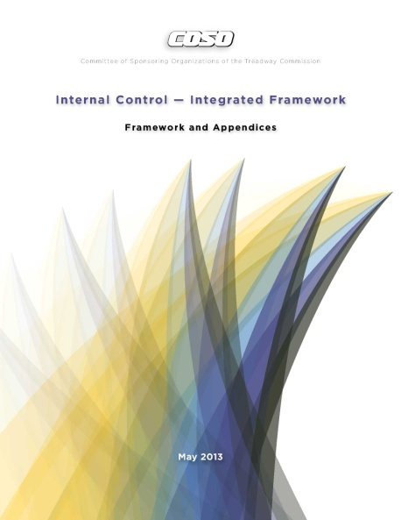
COSO Overview – Internal Control Publications
1992
2006
2009
2013

Slide 5
Why update what works – The Framework has become the most widely adopted control framework worldwide.
Original Framework
COSO’s Internal Control–Integrated Framework (1992 Edition)
Reflect changes in business & operating environments
Expand operations and reporting objectives
Articulate principles to facilitate effective internal control
Refresh Objectives
Enhancements
Updates
Context
Broadens Application
Clarifies Requirements
Updated Framework
COSO’s Internal Control–Integrated Framework (2013 Edition)

Slide 6
Project timetable
Assess & Survey Stakeholders
Design & Build
Public Exposure, Assess & Refine
Finalize
2010
2011
2012
2013

Slide 7
Project participants
COSO
Board of Directors
PwC
Author &
Project Leader
COSO Advisory Council
AICPA
AAA
FEI
IIA
IMA
Public Accounting Firms
Regulatory observers (SEC, GAO, FDIC, PCAOB)
Others (IFAC, ISACA, others)
Stakeholders
Over 700 stakeholders in Framework responded to global survey during 2011
Over 200 stakeholders publically commented on proposed updates to Framework during first quarter of 2012
Over 50 stakeholders publically commented on proposed updates in last quarter of 2012

Slide 8
Project deliverable #1 – Internal Control-Integrated Framework (2013 Edition)
Consists of three volumes:
Executive Summary
Framework and Appendices
Illustrative Tools for Assessing Effectiveness of a System of Internal Control
Sets out:
Definition of internal control
Categories of objectives
Components and principles of internal control
Requirements for effectiveness

Slide 9
Project deliverable #2 – Internal Control over External Financial Reporting: A Compendium....
Illustrates approaches and examples of how principles are applied in preparing financial statements
Considers changes in business and operating environments during past two decades
Provides examples from a variety of entities – public, private, not-for-profit, and government
Aligns with the updated Framework

Slide 10
Internal Control–Integrated Framework

Slide 11
Update expected to increase ease of use and broaden application
What is not changing... |  | What is changing...
Core definition of internal control Three categories of objectives and five components of internal control Each of the five components of internal control are required for effective internal control Important role of judgment in designing, implementing and conducting internal control, and in assessing its effectiveness |  | Changes in business and operating environments considered Operations and reporting objectives expanded Fundamental concepts underlying five components articulated as principles Additional approaches and examples relevant to operations, compliance, and non-financial reporting objectives added

Slide 12
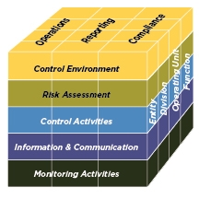
Update considers changes in business and operating environments
Environments changes... | …have driven Framework updates
Expectations for governance oversight
Globalization of markets and operations
Changes and greater complexity in business
Demands and complexities in laws, rules, regulations, and standards
Expectations for competencies and accountabilities
Use of, and reliance on, evolving technologies
Expectations relating to preventing and detecting fraud
COSO Cube (2013 Edition)

Slide 13
Update articulates principles of effective internal control
Control Environment
Demonstrates commitment to integrity and ethical values
Exercises oversight responsibility
Establishes structure, authority and responsibility
Demonstrates commitment to competence
Enforces accountability
Risk Assessment
Specifies suitable objectives
Identifies and analyzes risk
Assesses fraud risk
Identifies and analyzes significant change
Control Activities
Selects and develops control activities
11. Selects and develops general controls over technology
Deploys through policies and procedures
Information & Communication
Uses relevant information
Communicates internally
Communicates externally
Monitoring Activities
Conducts ongoing and/or separate evaluations
Evaluates and communicates deficiencies

Slide 14
Update articulates principles of effective internal control (continued)
Control Environment
The organization demonstrates a commitment to integrity and ethical values.
The board of directors demonstrates independence from management and exercises oversight of the development and performance of internal control.
Management establishes, with board oversight, structures, reporting lines, and appropriate authorities and responsibilities in the pursuit of objectives.
The organization demonstrates a commitment to attract, develop, and retain competent individuals in alignment with objectives.
The organization holds individuals accountable for their internal control responsibilities in the pursuit of objectives.

Slide 15
Update articulates principles of effective internal control (continued)
Risk Assessment
6. The organization specifies objectives with sufficient clarity to enable the identification and assessment of risks relating to objectives.
7. The organization identifies risks to the achievement of its objectives across the entity and analyzes risks as a basis for determining how the risks should be managed.
8. The organization considers the potential for fraud in assessing risks to the achievement of objectives.
9. The organization identifies and assesses changes that could significantly impact the system of internal control.

Slide 16
Update articulates principles of effective internal control (continued)
Control Activities
10. The organization selects and develops control activities that contribute to the mitigation of risks to the achievement of objectives to acceptable levels.
11. The organization selects and develops general control activities over technology to support the achievement of objectives.
The organization deploys control activities through policies that establish what is expected and procedures that put policies into place.

Slide 17
Update articulates principles of effective internal control (continued)
Information & Communication
13. The organization obtains or generates and uses relevant, quality information to support the functioning of internal control.
14. The organization internally communicates information, including objectives and responsibilities for internal control, necessary to support the functioning of internal control.
The organization communicates with external parties regarding matters affecting the functioning of internal control.

Slide 18
Update articulates principles of effective internal control (continued)
Monitoring Activities
16. The organization selects, develops, and performs ongoing and/or separate evaluations to ascertain whether the components of internal control are present and functioning.
The organization evaluates and communicates internal control deficiencies in a timely manner to those parties responsible for taking corrective action, including senior management and the board of directors, as appropriate.

Slide 19
Update clarifies requirements for effective internal control
Effective internal control provides reasonable assurance regarding the achievement of objectives and requires that:
Each component and each relevant principle is present and functioning
The five components are operating together in an integrated manner
Each principle is suitable to all entities; all principles are presumed relevant except in rare situations where management determines that a principle is not relevant to a component (e.g., governance, technology)
Components operate together when all components are present and functioning and internal control deficiencies aggregated across components do not result in one or more major deficiencies
A major deficiency represents an internal control deficiency or combination thereof that severely reduces the likelihood that an entity can achieve its objectives

Slide 20
Update describes important characteristics of principles, e.g.,
Control Environment
The organization demonstrates a commitment to integrity and ethical values.
Points of Focus:
Sets the Tone at the Top
Establishes Standards of Conduct
Evaluates Adherence to Standards of Conduct
Addresses Deviations in a Timely Manner
Points of focus may not be suitable or relevant, and others may be identified
Points of focus may facilitate designing, implementing, and conducting internal control
There is no requirement to separately assess whether points of focus are in place

Slide 21
Update describes the role of controls to effect principles
The Framework does not prescribe controls to be selected, developed, and deployed for effective internal control
An organization’s selection of controls to effect relevant principles and associated components is a function of management judgment based on factors unique to the entity
A major deficiency in a component or principle cannot be mitigated to an acceptable level by the presence and functioning of other components and principles
However, understanding and considering how controls effect multiple principles can provide persuasive evidence supporting management’s assessment of whether components and relevant principles are present and functioning

Slide 22
Update describes how various controls effect principles, e.g.,
Component
Principle
Controls embedded in other components may effect this principle
Control Environment
1. The organization demonstrates a commitment to integrity and ethical values.
Human Resources review employees’ confirmations to assess whether standards of conduct are understood and adhered to by staff across the entity
Control Environment
Management obtains and reviews data and information underlying potential deviations captured in whistleblower hot-line to assess quality of information
Information & Communication
Internal Audit separately evaluates Control Environment, considering employee behaviors and whistleblower hotline results and reports thereon
Monitoring Activities

Slide 23
Summary of public exposure of proposed update
Interest across geographic regions – approximately 50% of respondents from North America and 50% from international regions
Proposed updates to Framework released for public comments:
December 20, 2011 to March 31, 2012
September 18, 2012 to December 4, 2012
COSO sought comments from the general public on proposed updates, including whether the:
Requirements of effective internal control are clearly set forth
Roles of components, principles, and points of focus are clearly set forth
Framework remains sound, logical, and useful to management of entities of all types and sizes
Public comment letters available at www.ic.coso.org until Dec. 31, 2013

Slide 24
Updates are responsive to public comments
Principles
Provide clarity regarding the role of principles in designing, implementing, and conducting internal control, and assessing its effectiveness
Clarify descriptions of some principles, but no additional principles
Effectiveness
Recognize effective internal control can provide reasonable assurance of achieving effective and efficient operations objectives (as noted before)
Clarify requirement that each of the components and relevant principles must be present and functioning and components must operating together
Remove presumption that points of focus are present and functioning, and clarify that no separate assessment of points of focus is required
Standardize classification of internal control deficiencies, and clarify use of only relevant criteria established in laws, rules, regulations and standards

Slide 25
Updates are responsive to public comments (continued)
Objective Setting
Retain five components of internal control
Retain specification of objectives as a principle of effective internal control, but objective setting may be driven by laws, rules, regulations ,or external standards that are outside a system of internal control
Objectives
Retain view that safeguarding of assets primarily relates to operations objectives, and recognize its consideration within reporting and compliance
Acknowledge some laws rules, regulations and standards establish safeguarding of assets as a separate category of objectives
Retain view that strategic objectives is not part of internal control
Retain operations, reporting, and compliance objective categories, and expand descriptions

Slide 26
Updates are responsive to public comments (continued)
Enterprise Risk Management (ERM)
Retain distinction between ERM and internal control, and acknowledge these frameworks are complementary
Retain view that strategy-setting, strategic objectives, and risk appetite are aspects of ERM, not Internal Control-Integrated Framework
Retain discussion of risk appetite and application of risk tolerance
Smaller Entities and Governments – Provide additional guidance specific to smaller entities and governments (Appendix C)
Technology
Expand discussion in the points of focus and in several chapters
Decline suggestion to address risk associated with specific technologies because of the rapid pace of change

Slide 27
Updates are responsive to public comments (continued)
Structure and Layout – Retain view that all chapters 1-10 comprise the Framework
Due Process – COSO believes there has been a substantive due process effort to capture views on proposed update
Surveyed stakeholders to ascertain preferences concerning nature and extent of needed updates; 700 responses (December 2010 to September 2011)
Conducted eleven meetings with COSO Advisory Council
Provided exposure drafts of proposed updates for public comments (December 2011 to March 2012, and September to December 2012)
Participated in many conferences, webinars, and seminars with membership of COSO to seek views of stakeholders (January 2011 to January 2013)

Slide 28
Illustrative Documents:
Illustrative Tools for Assessing Effectiveness of a System of Internal Control
Internal Control over External Financial Reporting: A Compendium of Approaches and Examples

Slide 29
Illustrative Tools for Assessing Effectiveness of a System of Internal Control
Assist users when assessing effectiveness of internal control based on the requirements set forth in the Framework
Templates illustrate a possible summary of assessment results
Scenarios illustrate practical examples of how the templates can be used to support an assessment and important considerations in performing an assessment
Focus on evaluating components and relevant principles, not the underlying controls that affect relevant principles
Cannot satisfy criteria established through laws, rules, regulations, or external standards for evaluating the severity of internal control deficiencies
Can customize level and amount of detail included in the templates as management may deem necessary

Slide 30
Internal Control over External Financial Reporting (ICEFR): A Compendium of Approaches and Examples
Approaches and Examples illustrate how various characteristics of principles may be present and functioning within a system of internal control relating to external financial reporting
Approaches are designed to give a summary-level description of activities that management may consider as they apply the Framework
Examples illustrate one or more points of focus of a particular principle. They are not designed to provide a comprehensive, end-to-end example of how a principle may be fully applied in practice.
Selected approaches and examples do not illustrate all aspects of components and relevant principles that would be necessary for effective internal control
Stakeholders should refer to the Framework for the requirements of effective internal control
Compendium supplements and can be used in concert

Slide 31
Summary of public exposure of the Illustrative Documents
Proposed Internal Control over External Financial Reporting: Compendium of Approaches and Examples was released for public comment from September 18, 2012 to December 4, 2012
In conjunction with the public exposure of ICEFR Compendium, COSO made available revised versions of the previously exposed Framework and Appendices and Executive Summary
COSO made available the proposed Illustrative Tools for Assessing Effectiveness of a System of Internal Control
COSO sought comments from the general public on relevant topics
Public comment letters available at www.ic.coso.org until Dec. 31, 2013

Slide 32
Illustrative documents are responsive to public comments
ICEFR: A Compendium of Approaches and Examples
Add or clarify specific examples, including:
Establishing responsibilities for reviewing financial statements
Monitoring investigation and reporting of whistleblower allegations
Monitoring identification and protection of sensitive financial information
Monitoring identification and analysis of risk of material misstatement due to fraud
Address a risk-based approach for achieving external financial reporting objectives
Specify suitable objectives for external financial reporting
Risks to achieving suitable objectives
Responses to risks

Slide 33
Transition & Impact

Slide 34
Transition & Impact
Users are encouraged to transition applications and related documentation to the updated Framework as soon as feasible
Updated Framework will supersede original Framework at the end of the transition period (i.e., December 15, 2014)
During the transition period, external reporting should disclose whether the original or updated version of the Framework was used
Impact of adopting the updated Framework will vary by organization
Does your system of internal control need to address changes in business?
Does your system of internal control need to be updated to address all principles?
Does your organization apply and interpret the original framework in the same manner as COSO?
Is your organization considering new opportunities to apply internal control to cover additional objectives?

Slide 35
Transition & Impact (continued)
The principles-based approach provides flexibility in applying the Framework to multiple, overlapping objectives across the entity
Easier to see what is covered and what is missing
Focus on principles may reduce likelihood of considering something that’s irrelevant
Understanding the importance of specifying suitable objectives focuses on those risks and controls most important to achieving these objectives.
Focusing on areas of risk that exceed acceptance levels or need to be managed across the entity may reduce efforts spent mitigating risks in areas of lesser significance.
Coordinating efforts for identifying and assessing risks across multiple, overlapping objectives may reduce the number of discrete risks assessed and mitigated.

Slide 36
Transition & Impact (continued)
Selecting, developing, and deploying controls to effect multiple principles may also reduce the number of discrete, layered-on controls.
Applying an integrated approach to internal control - encompassing operations, reporting, and compliance – may lessen complexity.
In assessing severity of internal control deficiencies, use only the relevant classification criteria as set out in the Framework or by regulators, standard-setting bodies, and other relevant third parties, as appropriate.

Slide 37
Recommended Actions
Read COSO’s updated Framework and illustrative documents
Educate the audit committee, C-suite, operating unit and functional management
Establish a process for identifying, assessing, and implementing necessary changes in controls and related documentation
Develop and implement a transition plan timely to meet key objectives – e.g., apply updated Framework by December 31, 2014 for external reporting

Slide 38
Getting COSO’s Publications
The updated Framework and related Illustrative documents are available in 3 layouts
E-book – This layout is ideally suited for those wanting access in electronic format for tablet use. An e-book reader from the AICPA is required to view this layout. Printing is restricted in this layout.
Purchase through www.cpa2biz.com
Paper-bound – This layout is ideally suited for those wanting a hard copy.
Purchase through www.cpa2biz.com
PDF – This layout is ideally suited for organizations interested in licensing multiple copies.
Contact the AICPA at copyright@aicpa.org

Slide 39
Questions & Comments

